Slide 1
Telecommunications and Utilities

Slide 2
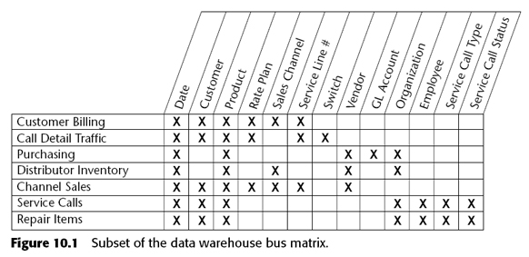
Data Warehouse Bus Matrix

Slide 3
Business Process

Slide 6
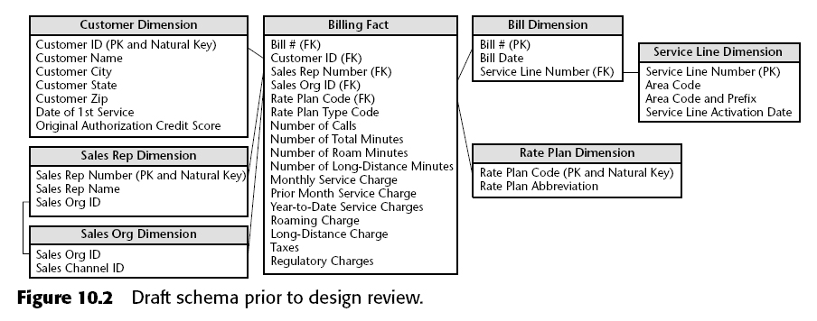
Fact table
Grain = 1 row แสดงถึง 1 Bill ในแต่ละเดือน

Slide 8
Granularity

Slide 9
Fact Granularity

Slide 10
Dimension Granularity

Slide 11
Date Dimension

Slide 12
Fixed Time-Series Bucket แทน Date Dimension

Slide 13
Degenerate Dimension

Slide 15
Dimension Decodes and Descriptions

Slide 16
Surrogate Keys

Slide 17
Too Many (Too Low)Dimension

Slide 18
Draft Design Exercise Discussion

Slide 20
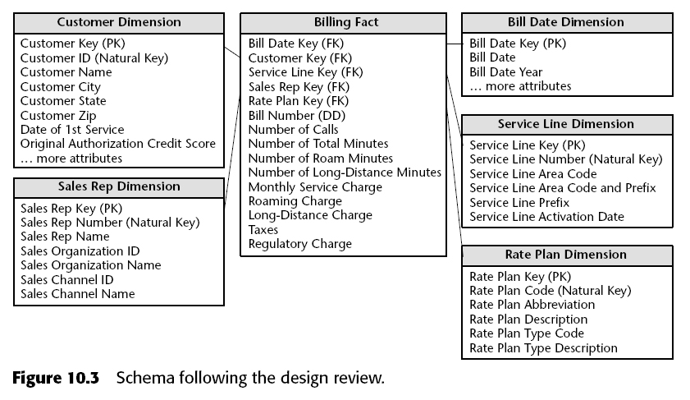

Slide 26
Geographic Location Dimension

Slide 28
Location Outrigger

Slide 30
Leveraging Geographic Information System

Slide 33
ส่วนที่หามาเพิ่ม

Slide 34
http://www-01.ibm.com/support/docview.wss?uid=swg24022618

Slide 35
http://www.informatica.com/solutions/telecommunications/Pages/index.aspx

Slide 36
http://www.infobright.com/Products/MySQL-Integration/

Slide 37
http://www.stragechom.com/industries/telecommunication_and_utilities.html
http://www.co.escambia.fl.us/Bureaus/PublicWorks/Telecommunications.html
http://www.martindawessystems.com/pdfs/businessmoney.pdf
http://www.realmarket.com/required/hp11.pdf
http://www-01.ibm.com/support/docview.wss?uid=swg24022618
http://www.informatica.com/solutions/telecommunications/Pages/index.aspx
http://itc.scix.net/data/works/att/w78-1999-2395.content.pdf
http://www.infobright.com/Products/MySQL-Integration/

